Slide 2
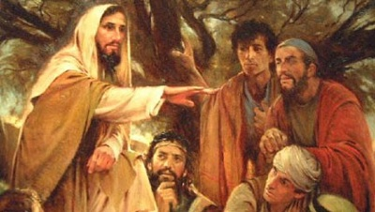
Sermon on the Mount
Matthew 5-7

Slide 3
Sermon
on
the Mount
Matthew 5:21-26
THE ACT OF MURDER
  Accidental ; 2) Legal, war; 3) Defensive, protection; 4)Murder
  Not JUST ALL KILLING!
RESULT OF MURDER UNDER OLD TESTAMENT
Judgment – Deuteronomy 19:11-13
“But I say to you…” Matthew 5:22-26
  Right Relationships Will Avoid Act of Murder v.22
  Right Relationships Without Unjustifiable Anger “without cause”
  Ephesians 4:26 “Be angry, and do not sin”
  Anger Harbored in heart is Sinful – “do not let sun go down on your wrath”

Slide 4
Sermon
on
the Mount
Matthew 5:21-26
“But I say to you…” Matthew 5:22-26
  Right Relationships Will Avoid Act of Murder v.22
  Right Relationships Without Unjustifiable Anger “without cause”
  Ephesians 4:26 “Be angry, and do not sin”
  Anger Harbored in heart is Sinful – “do not let sun go down on your wrath”
  Right Relationships Without Murderous Speech v.22
  “Raca”- vain, empty, worthless
  Luke 12:20; James 2:20; 1 Corinthians 15:36; Luke 24:25
THE EMPHASIS IS THE HEART

Slide 5
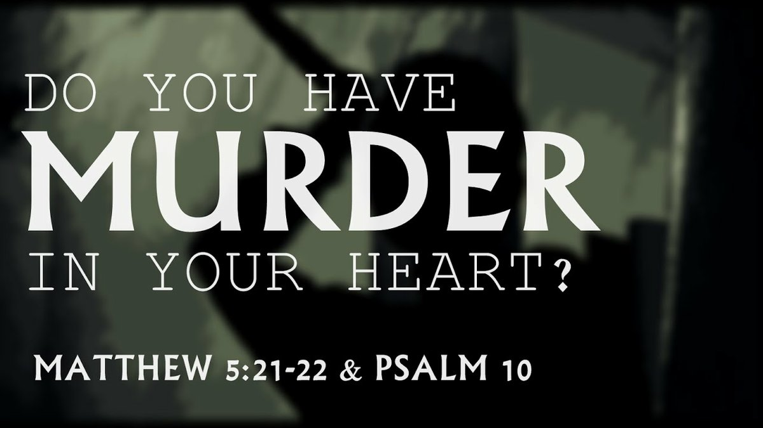
Sermon
on
the Mount
Matthew 5:21-26
WHY DO CHRISTIANS GO AROUND BACKBITING AND SHOWING MEANNESS TOWARD OTHERS?
Galatians 5:15 “beware lest you be consumed…”
Never any justification for mean spiritedness aimed at destroying the character of another.
RIGHT RELATIONSHIPS WITHOUT DIVISION, QUARRELING AND OFFENSES
  Mark 11:25,26 forgiveness others

Slide 6
Sermon
on
the Mount
Matthew 5:21-26
How Do I Feel About My Anger Toward Another When I Seek God In Some Form Of Worship?
  Luke 18:10,11
  Luke 18:14
Have you ever been sharp, and said mean things?
  Only to go off with pride, nose high in the air, never to return to straighten out the difference?
Have you ever hurt another in some way?
  All such things cause others to feel hurt by us.
  We just can’t worship like that

Slide 7
Sermon
on
the Mount
Matthew 5:21-26
IF I have wronged anyone – I must right that wrong, make restitution, seek to rebuild and repair
  Matthew 5:25,26 – IF I don’t correct my anger, I may produce an enemy who will some day try to get EVEN with me!
CAN’T MURDER
CAN’T HATE
CAN’T VERBALLY KILL
CAN’T PRETEND I HAVEN’T WRONGED SOMEONE, MUST SEEK TO SETTLE EACH AND EVERY OFFENSE
EVEN BE KIND TO MY ENEMIES

